Slide 1
Data Analytics Internship Project
Name:Bugatha tejaswini
Internship:ApexPlanet Internship Program
Date:May 2026 – June 2026

Slide 2
Project Introduction:
This project focuses on analyzing the Superstore Sales dataset to identify business trends, sales performance, customer behavior, and regional profitability using data analytics tools and visualization techniques.
The project includes data cleaning, exploratory data analysis, SQL querying, dashboard creation, and business storytelling.

Slide 3
Objectives:
Analyze sales and profit trends
Identify top-performing product categories
Compare regional sales performance
Understand customer segments
Build interactive dashboards
Generate business insights for decision-making

Slide 4
Tools Used:
Tool | Purpose
Python | Data Cleaning & EDA
MySQL Workbench | SQL Query Analysis
Excel | Dashboard Creation
Power BI | Interactive Dashboard
GitHub | Project Repository

Slide 5
Dataset Overview:
Dataset Contains:
Orders data
Product categories
Customer segments
Regional sales information
Profit and discount details
Important Columns:
Sales
Profit
Category
Region
Segment
Order Date

Slide 6
Data Cleaning Process:
Mention:
Libraries used:
Pandas
NumPy
Content
Steps Performed:
Imported dataset using Python
Checked missing values
Removed duplicate records
Corrected inconsistent formats
Converted date columns
Prepared analysis-ready dataset

Slide 7
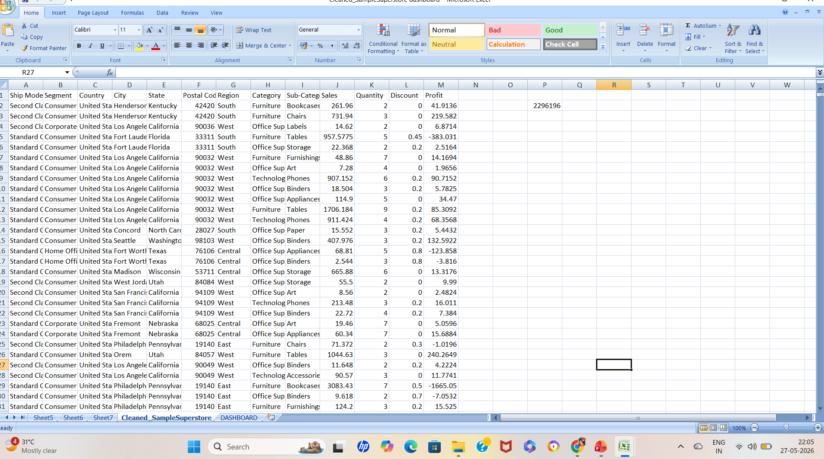
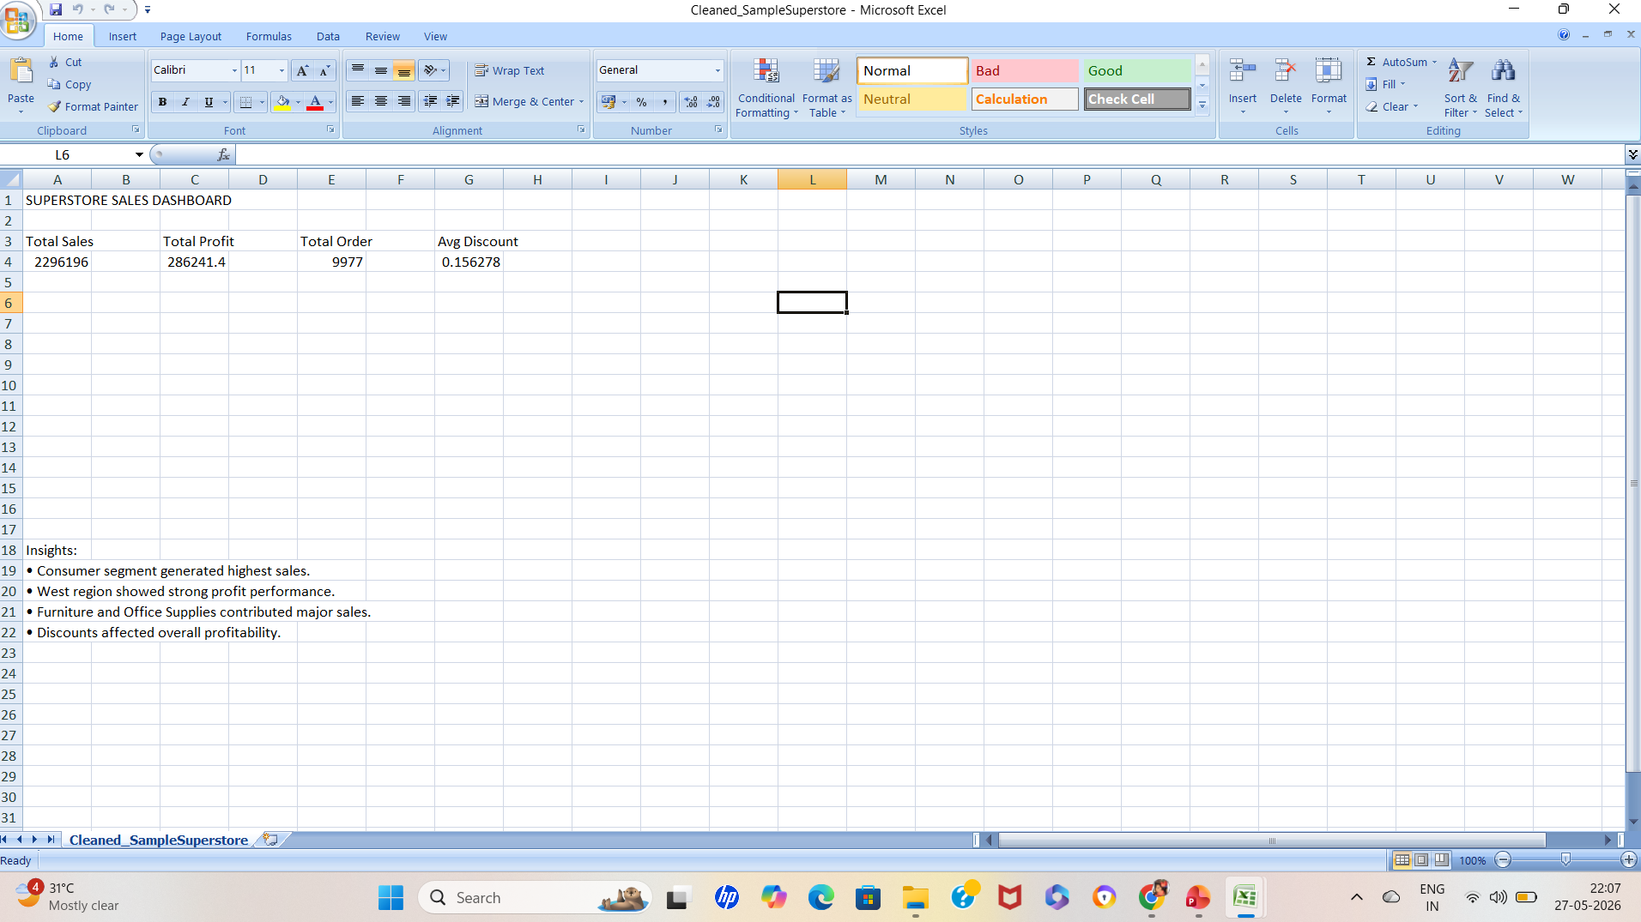
Cleaned Dataset:
Achievements:
Improved data quality
Standardized dataset structure
Reduced inconsistencies
Enabled accurate analysis

Slide 8
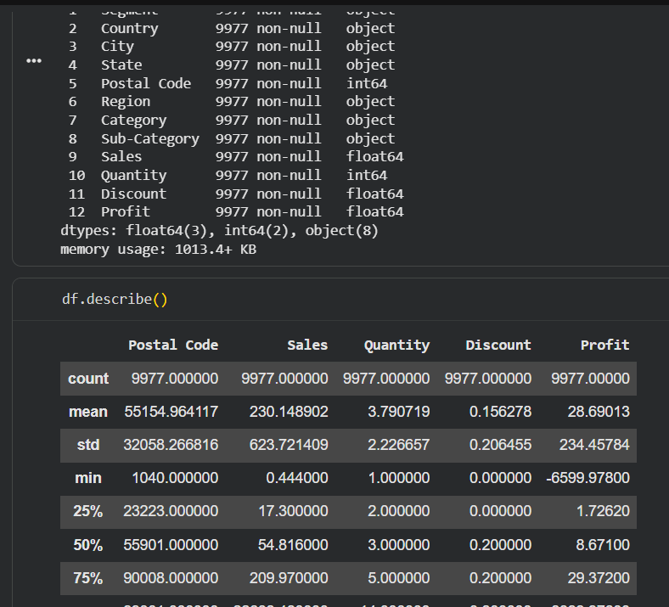
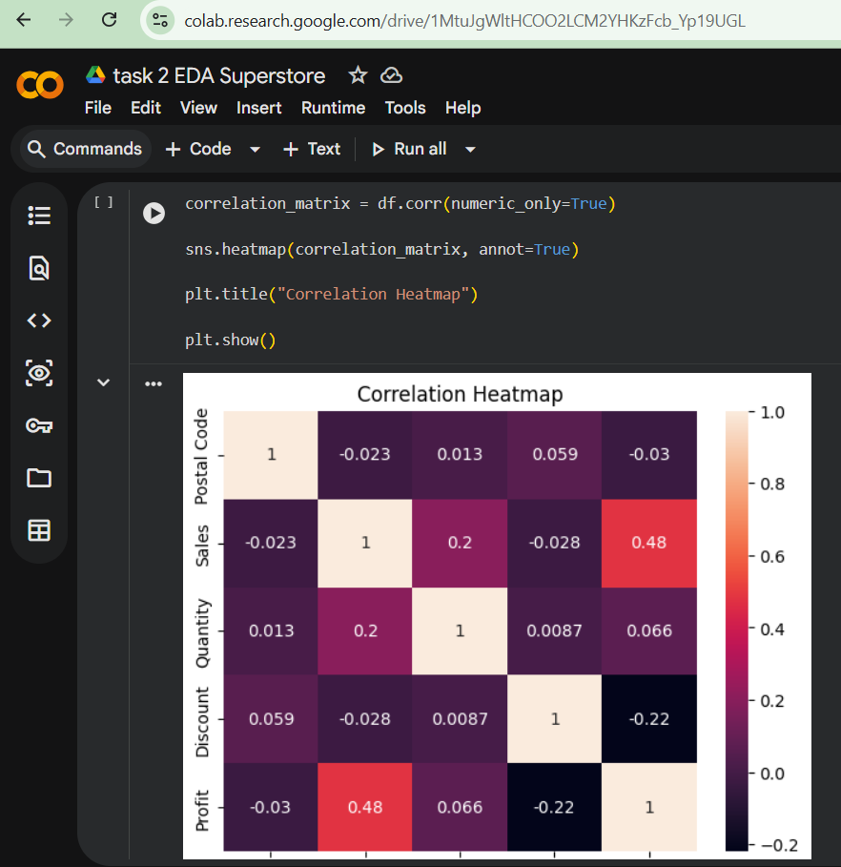
Exploratory Data Analysis:
Analysis Performed:
Sales by Category
Profit by Region
Sales by Segment
Yearly Sales Trend
Discount Impact Analysis

Slide 9
Excel Dashboard Analysis:
An interactive Excel dashboard was created to visualize sales performance, regional profit distribution, and customer segment contribution.
The dashboard provides a quick overview of important business metrics and helps identify sales trends and profitability patterns.

Slide 10
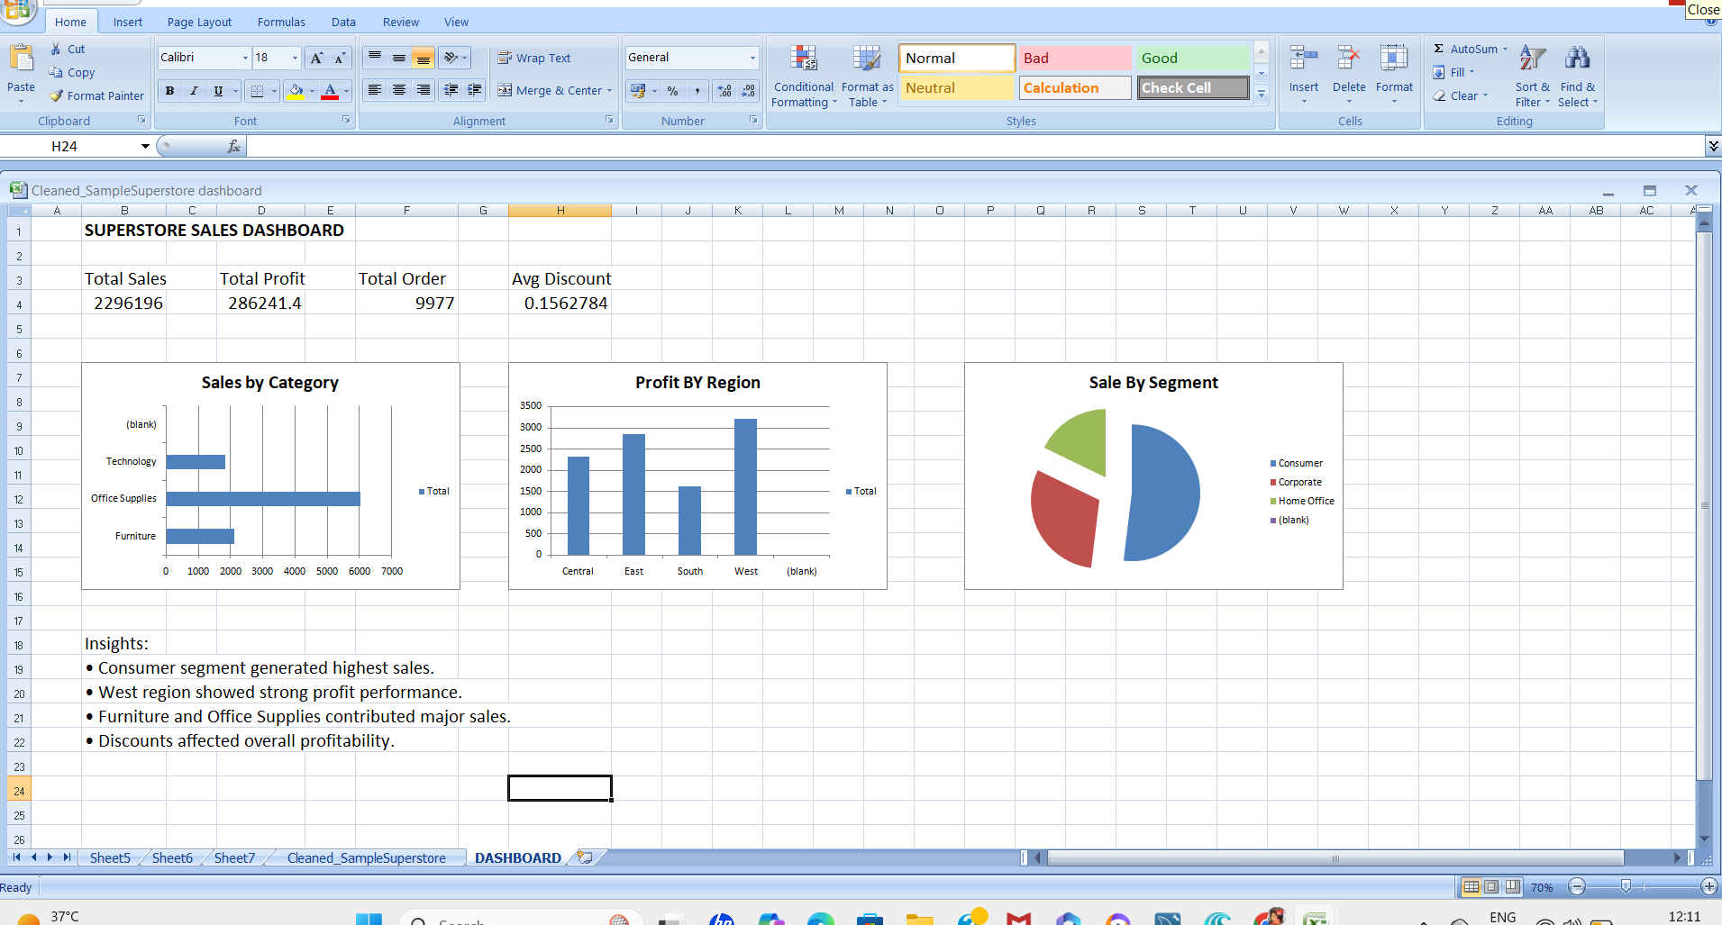
Excel Dashboard:
Dashboard Highlights
Sales by Category analysis
Profit by Region comparison
Sales contribution by Segment
KPI summary metrics
Business insights section

Slide 11
SQL Business Analysis:
SQL queries were used to extract meaningful business insights from the Superstore dataset. Different queries were written to analyze sales trends, category performance, and regional profitability.
Business Questions Solved
Which category generated highest sales?
Which region produced highest profit?
What is the yearly sales trend?
Which customer segment contributed most sales?
Which products generated maximum revenue?

Slide 12
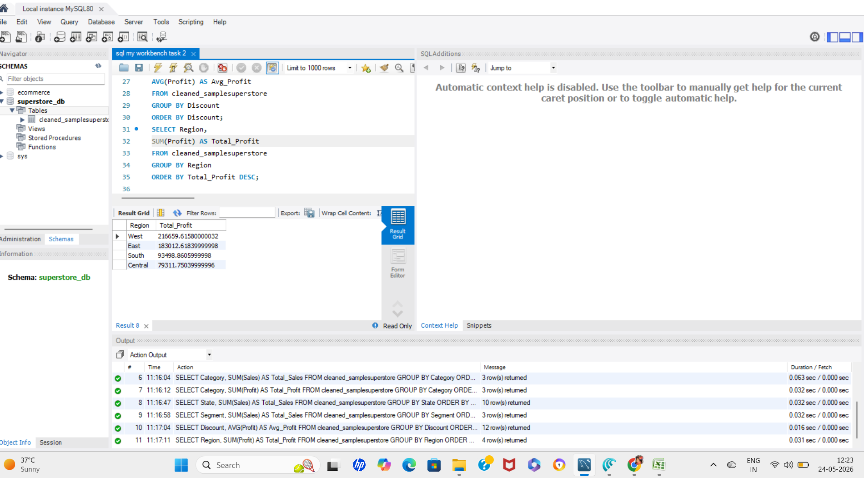
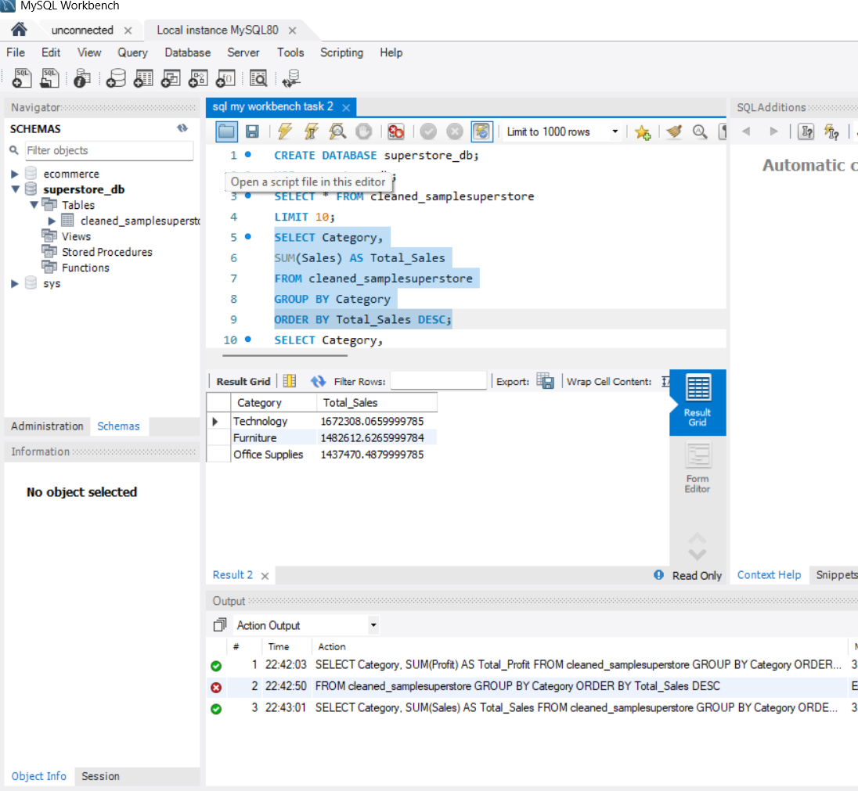
SQL Business Analysis:
SQL Operations Used
SELECT
WHERE
GROUP BY
ORDER BY
SUM()
AVG()
COUNT()

Slide 13
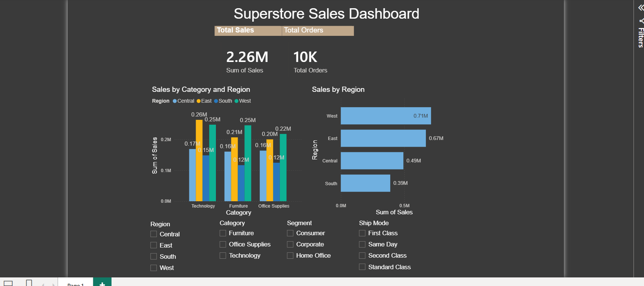
Interactive Power BI Dashboard:
Features:
Dynamic filters
KPI cards
Region-wise analysis
Category-wise analysis
Segment filtering
Interactive visuals

Slide 14
Key Performance Indicators:
KPI | Value
Total Sales | 2.26 Million
Total Orders | 10K
Best Performing Region | West
Top Segment | Consumer
Highest Sales Category | Technology

Slide 15
Business Insights:
Consumer segment generated highest sales
West region achieved strong sales performance
Technology category contributed highest revenue
Discounts impacted profitability
Sales showed growth trend over years

Slide 16
Business Story:
The analysis reveals that the business performed strongly in the West region, especially in the Technology category. Consumer customers contributed major sales revenue, while discounts reduced overall profitability in some categories.
Interactive dashboards helped identify important trends and business opportunities.

Slide 17

Statistical Validation:
Business Hypothesis:
West region sales are significantly higher than South region sales.
Null Hypothesis (H₀)
$\text{West} \text{Sales}\text{ = }\text{South} \text{Sales}$
Alternative Hypothesis (H₁)
$\text{West} \text{Sales}\text{ > }\text{South} \text{Sales}$
If:
$p<0.05$
then result is statistically significant.
$p<0.05$

Slide 18
Statistical Conclusion:
The statistical testing indicates that the West region performed significantly better in sales compared to the South region.
This supports the business insight obtained from the dashboard analysis.

Slide 19
Challenges & Learning:
Challenges:
Handling missing data
Building meaningful visualizations
Understanding business KPIs
Dashboard formatting
Skills Learned:
Data Cleaning
SQL Query Writing
Dashboard Design
Business Analytics
Data Storytelling

Slide 20
Conclusion:
This project successfully transformed raw sales data into actionable business insights using data analytics tools and visualization techniques.
The dashboards and analysis helped understand customer behavior, sales trends, and regional performance effectively.

Slide 21
Future Scope:
Content
Add predictive analytics
Create real-time dashboards
Perform customer segmentation
Use machine learning models
Build automated reporting systems

Slide 22
THANK YOU
PROFILE LINKS:
GITHUB LINK: https://github.com/tejaswinibugatha
LINKEDIN LINK: https://www.linkedin.com/in/teju-bugatha-744a692b6?utm_source=share_via&utm_content=profile&utm_medium=member_android
“THANK YOU FOR ATTENTION”

